Slide 1
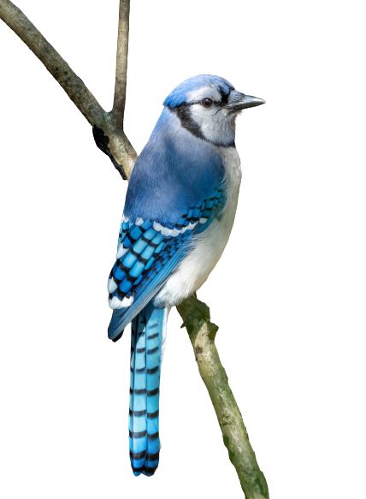
IRSS Hackathon 2023 FeederWatch
Harry and Bud
Thursday, August 17th, 2023

Slide 2
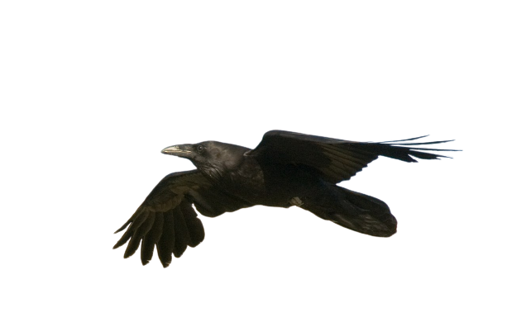
Dataset
Birds, birds, birds!
Project FeederWatch – TidyTuesday
Birdwatchers sit in their yards and record what birds show up at their feeders
Information on location, date, species, number of birds, time of day
Joinable information on habitats, other animals (cat, dog, humans), and if the bids have been fed (and when)

Slide 3
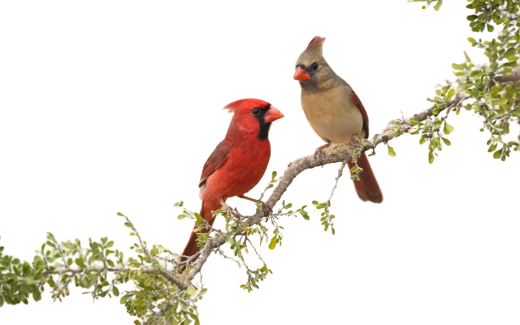
Your task (should you choose to accept it)
Make a plot
Make a map
Make a story
Do some statistics
Present it!

Slide 4
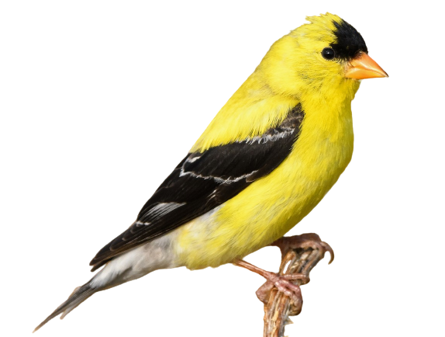
Some ideas
Find out which types of birds show up in heavy snow?
How does the presence of cats and dogs influence bird density?
Does feeding birds lead to more birds actually showing up?
How does housing density affect pigeon density?
Which habitats or types of feeders do bluejays prefer?
What’s the rarest bird in these counts?

Slide 5
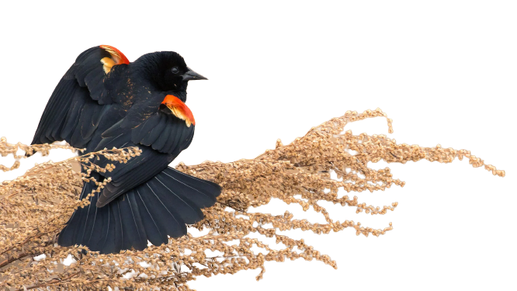
This is all for fun!
Group 1 | Group 2 | Group 3 | Group 4 | Group 5 | Group 6 | Group 7 | Group 8 | Group 9
Evan Muise | Tristan Goodbody | Lukas Jarron | Aria Guo | Amy Wotherspoon | Rik Nuijten | Alexis Achim | James Maltman | Chris Colton
Hana Travers-Smith | Claire Armour | Chris Mulverhill | Liam Irwin | Ramon Melser | Alexandre Morin-Bernard | Lukas Olson | Aidan Perkins | Melissa Birch
Brent Murray | Harry Seely | Evan Gerbrecht | Leanna Stackhouse | Jen Grenz | Elaine Ye | Samuel Grubinger | Sarah Zwiep (Vaughan) | Jeremy Arkin
Rapheal Pouliot | Gonzalo Gavilan | Sarah Smith-Tripp | Paul Hacker | Francois du Toit | Kirk Johnson | Madison Brown | Stefano Puliti | Spencer Dakin Kuiper
Nicholas Coops | Tiziana Li Koch |  | Tommaso Trotto | Spencer Shields | Jose Riofrio | Spencer Dakin Kuiper | Andrew Chadwick | Mohamed Elhefnawy

